Slide 1

SilkSync 🌏✨
Team BevGo!
👥 Emerson Wang (PO/Frontend), Kevin Zhang (Backend), Jason Pan (Integration), Kiana Penner (QA)
Tireless Travel
📅 March 7, 2026

Slide 2
• Goal: Unified travel experience (train reservations, currency conversion, dual-map navigation)
• Firewall restrictions
Problem Domain & Motivation 🚧💭
• Fragmented travel tools
• Unreliable Google Maps

Slide 3

System Overview & Key Technologies 🧭⚙️
• Architecture: Geo Dual-Map Architecture
• Features: Dynamic Budget Mapping, Train-Find Social Sync,
• Technologies: Firebase Auth, Mapbox SDK, Amap SDK, Currency APIs, React, MCP

Slide 4
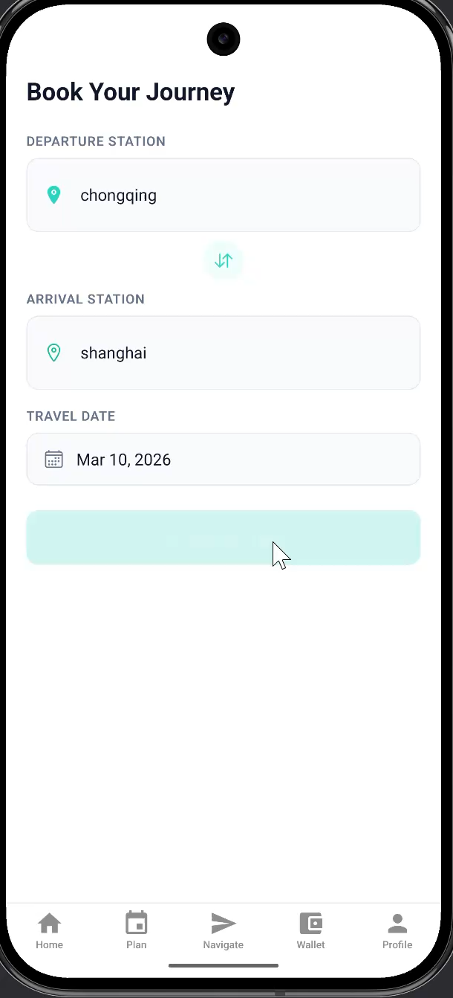
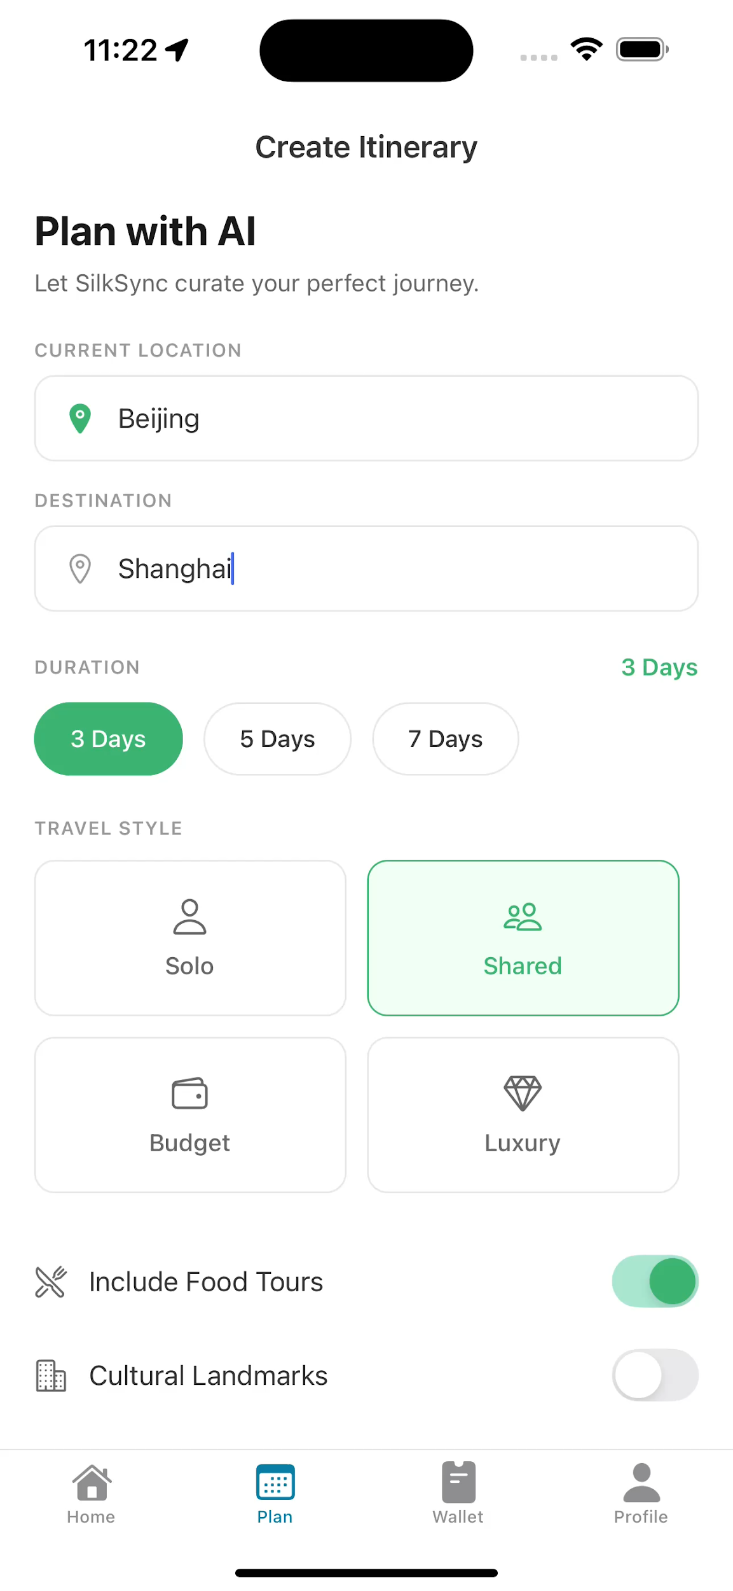
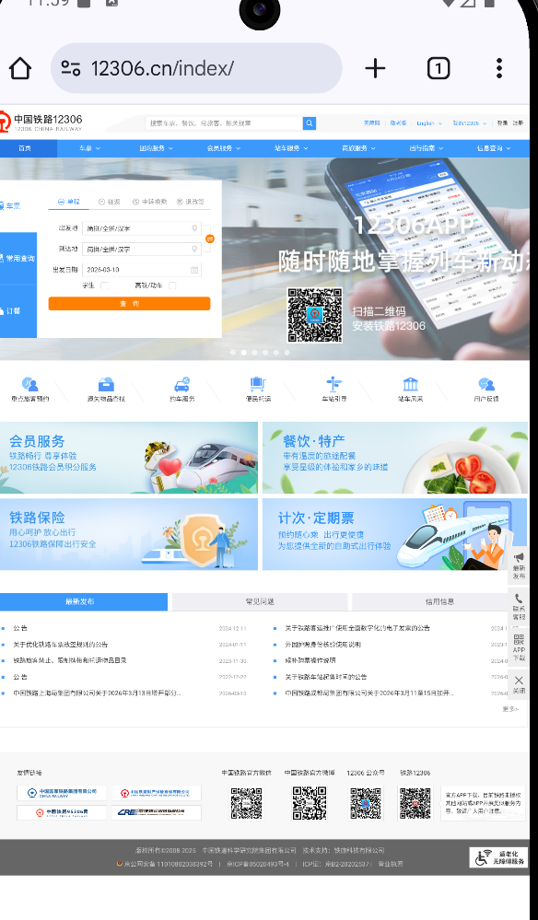
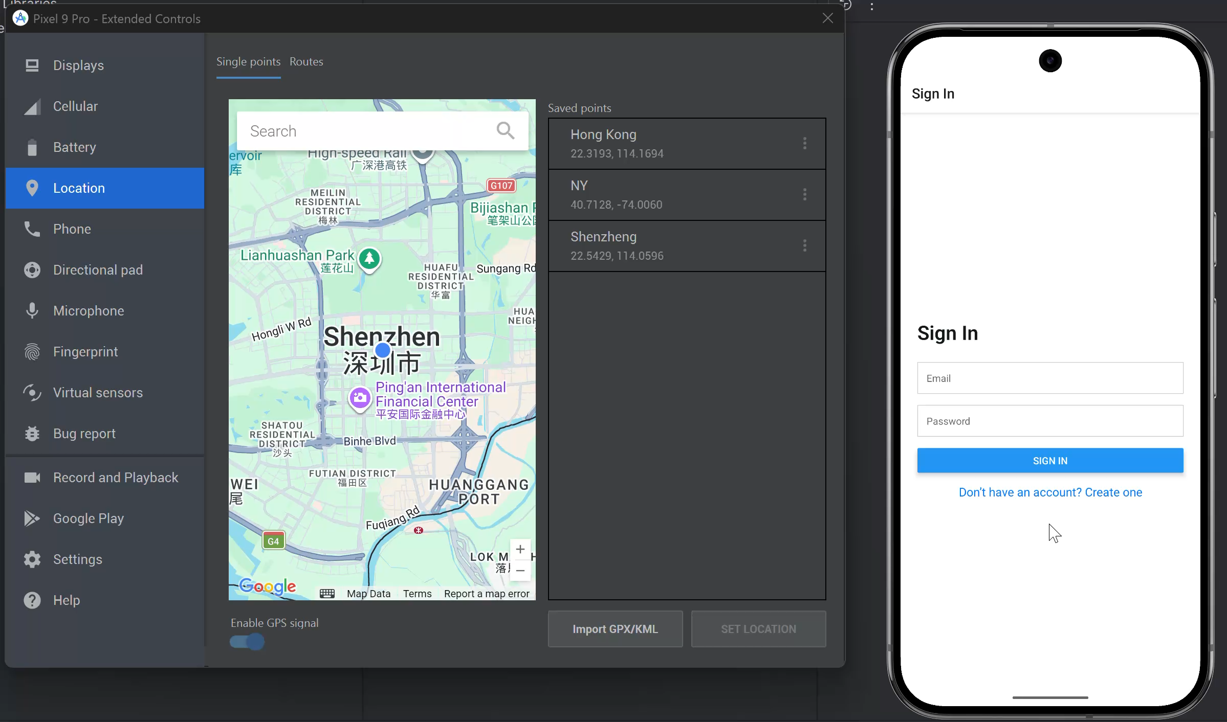
Product Demo 📱🎥
• Placeholders for screenshots
• Login & Sign-Up UI
• Cost Breakdown interface
• Map transition: Mapbox → Amap

Slide 5

Scrum Process & Project Management 🧩📅
Framework: 4-week Scrum cycles
Tools: Jira, Discord
Technique: Planning Poker (Account Core = 21 points)

Slide 6



Challenges ⚠️📈
• KNOWLEDGE GAP: SPRINT 2 PLANNED 49H, ACTUAL 35H
• EXTERNAL RISKS: API CREDENTIAL DELAYS
• PO DECISIONS EXAMPLE: MOVE OFFLINE MODE TO BACKLOG

Slide 7

Lessons Learned & Team Growth 🌱🤝
Proactive communication
Lab utilization
Collaborative voting

Slide 8


Conclusion & Future Work 🌟🚀
• SUCCESS: DELIVERED A FUNCTIONAL, UNIFIED TRAVEL PLATFORM
• FUTURE: IMPLEMENT OFFLINE MODE, REFINE HSR SEARCH FEATURES

Slide 9

Thank You

